Slide 1
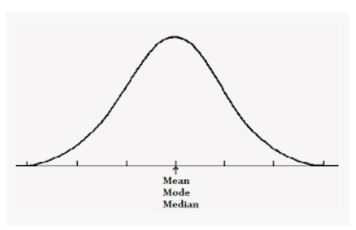
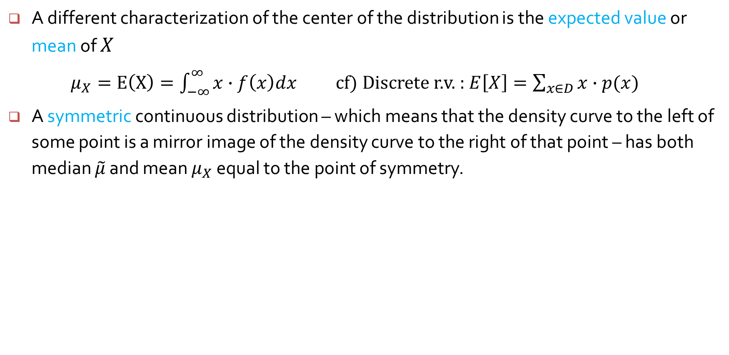
Mean of a continuous random variable
A different characterization of the center of the distribution is the expected value or mean of $X$
$μ_{X}=E\left(X\right)=\int_{−∞}^{∞}{x∙f\left(x\right)dx}$ cf) Discrete r.v. : $E\left[X\right]=\sum_{x∈D}{x∙p(x)}$
A symmetric continuous distribution – which means that the density curve to the left of some point is a mirror image of the density curve to the right of that point – has both median $\tilde{μ}$ and mean $μ_{X}$ equal to the point of symmetry.

Slide 2
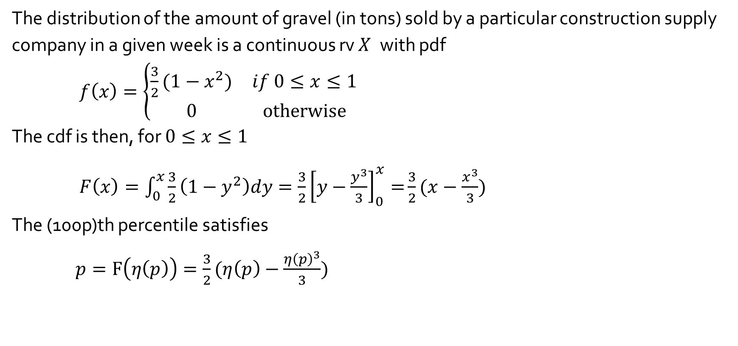
Example 4.9
The distribution of the amount of gravel (in tons) sold by a particular construction supply company in a given week is a continuous rv $X$ with pdf
$f\left(x\right)=\left\{\begin{matrix}\frac{3}{2}(1−x^{2}) & if 0≤x≤1 \\ 0 & otherwise\end{matrix}\right.$
The cdf is then, for $0≤x≤1$
$F\left(x\right)=\int_{0}^{x}{\frac{3}{2}\left(1−y^{2}\right)dy=\frac{3}{2}{\left[y−\frac{y^{3}}{3}\right]}_{0}^{x}=}\frac{3}{2}(x−\frac{x^{3}}{3})$
The (100p)th percentile satisfies
$p=F\left(η\left(p\right)\right)=\frac{3}{2}(η\left(p\right)−\frac{{η\left(p\right)}^{3}}{3})$

Slide 3
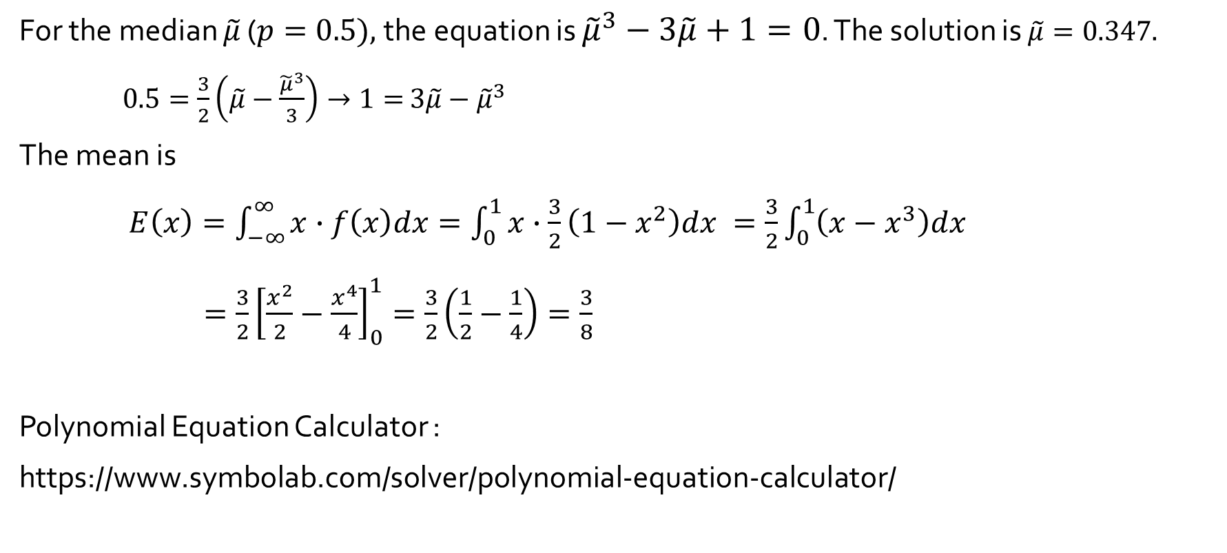
Example 4.9 (cont’d)
For the median $\tilde{μ}$ ($p=0.5),$the equation is ${\tilde{μ}}^{3}−3\tilde{μ}+1=0$. The solution is $\tilde{μ}=0.347.$
$0.5=\frac{3}{2}\left(\tilde{μ}−\frac{{\tilde{μ}}^{3}}{3}\right)→1=$ $3\tilde{μ}−{\tilde{μ}}^{3}$
The mean is
$E\left(x\right)=\int_{−∞}^{∞}{x∙f\left(x\right)dx}=\int_{0}^{1}{x∙\frac{3}{2}\left(1−x^{2}\right)dx }=\frac{3}{2}\int_{0}^{1}{\left(x−x^{3}\right)dx }$
$=\frac{3}{2}{\left[\frac{x^{2}}{2}−\frac{x^{4}}{4}\right]}_{0}^{1}=\frac{3}{2}\left(\frac{1}{2}−\frac{1}{4}\right)=\frac{3}{8}$
Polynomial Equation Calculator :
https://www.symbolab.com/solver/polynomial-equation-calculator/

Slide 4
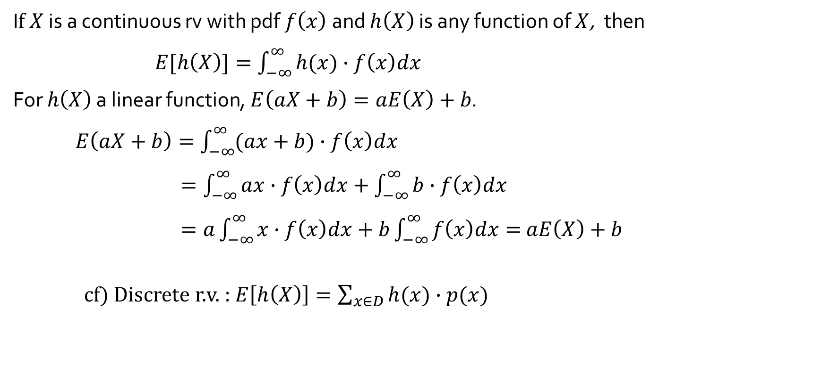
Expected value of a function of a rv
I$f X$ is a continuous rv with pdf $f\left(x\right)$ and $h\left(X\right)$ is any function of $X$, then
$E[h\left(X\right)]=\int_{−∞}^{∞}{h(x)∙f\left(x\right)dx}$
For $h\left(X\right)$ a linear function, $E\left(aX+b\right)=aE\left(X\right)+b$.
$E\left(aX+b\right)=\int_{−∞}^{∞}{(ax+b)∙f\left(x\right)dx}$
$=\int_{−∞}^{∞}{ax∙f\left(x\right)dx}+\int_{−∞}^{∞}{b∙f\left(x\right)dx}$
$=a\int_{−∞}^{∞}{x∙f\left(x\right)dx}+b\int_{−∞}^{∞}{f\left(x\right)dx}=$ $aE\left(X\right)+b$
cf) Discrete r.v. : $E\left[h\left(X\right)\right]=\sum_{x∈D}{h(x)∙p(x)}$

Slide 5
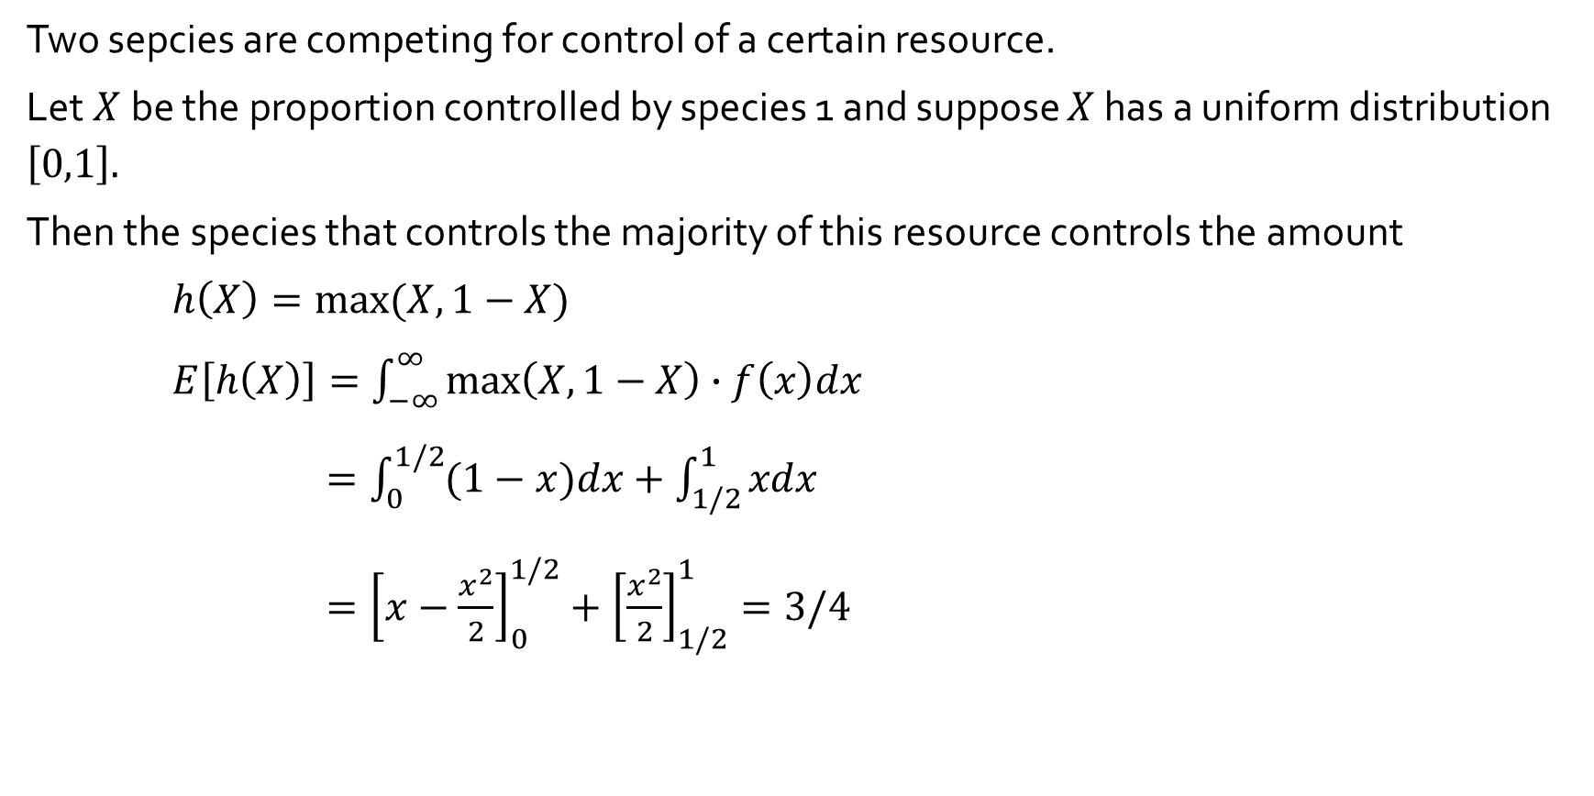
Example 4.11
Two sepcies are competing for control of a certain resource.
Let$X$be the proportion controlled by species 1 and suppose $X$ has a uniform distribution $\left[0,1\right].$
Then the species that controls the majority of this resource controls the amount
$h\left(X\right)=max⁡(X, 1−X)$
$E\left[h\left(X\right)\right]=\int_{−∞}^{∞}{\max\left(X, 1−X\right)∙f\left(x\right)dx}$
$=\int_{0}^{1/2}{(1−x)dx}+\int_{1/2}^{1}{xdx}$
$={\left[x−\frac{x^{2}}{2}\right]}_{0}^{1/2}+{\left[\frac{x^{2}}{2}\right]}_{1/2}^{1}=3/4$

Slide 6
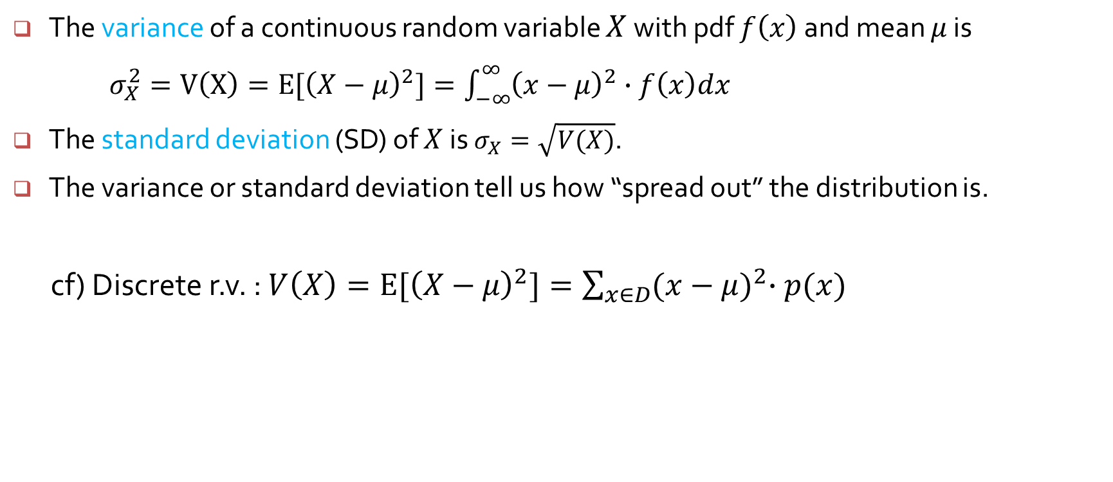
Variance of a continuous random variable
The variance of a continuous random variable $X$ with pdf $f\left(x\right)$ and mean $μ$ is
$σ_{X}^{2}=V\left(X\right)=E[{\left(X−μ\right)}^{2}]=\int_{−∞}^{∞}{{\left(x−μ\right)}^{2}∙f\left(x\right)dx}$
The standard deviation (SD) of $X$ is $σ_{X}=\sqrt{V(X)}$.
The variance or standard deviation tell us how “spread out” the distribution is.
cf) Discrete r.v. : $V\left(X\right)=E[{\left(X−μ\right)}^{2}]=\sum_{x∈D}{{(x−μ)}^{2}∙p(x)}$

Slide 7
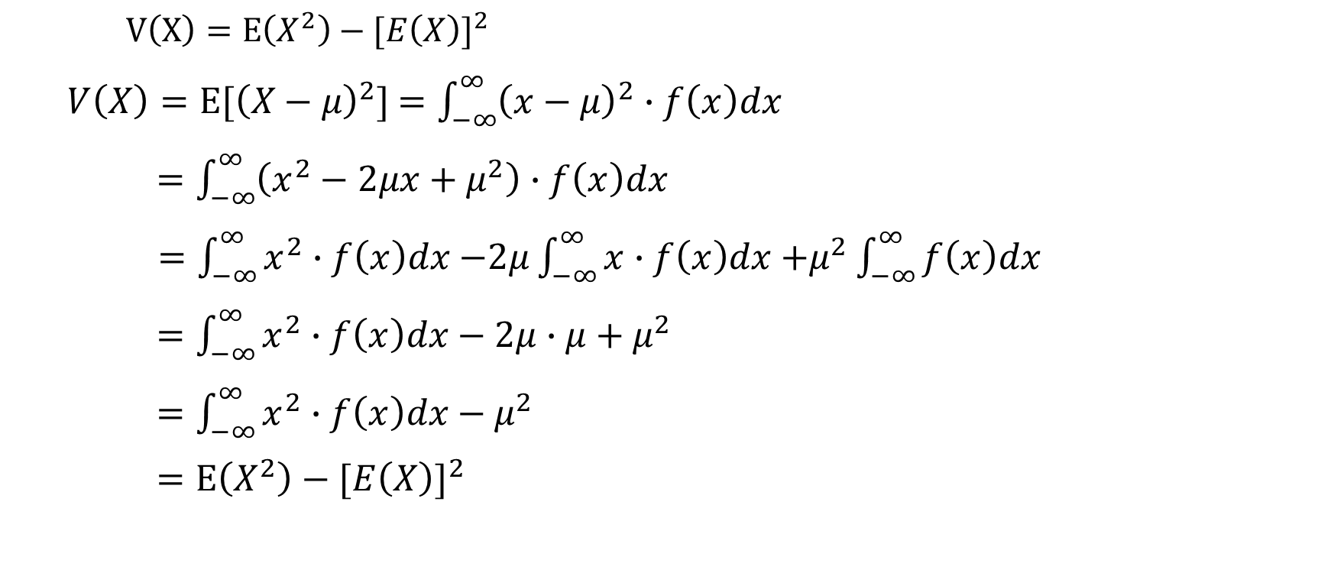
A shortcut formula for variance
$V\left(X\right)=E\left(X^{2}\right)−{[E\left(X\right)]}^{2}$
$V\left(X\right)=E[{\left(X−μ\right)}^{2}]$ $=\int_{−∞}^{∞}{{\left(x−μ\right)}^{2}∙f\left(x\right)dx}$
$=\int_{−∞}^{∞}{\left(x^{2}−2μx+μ^{2}\right)∙f\left(x\right)dx}$
$=\int_{−∞}^{∞}{x^{2}∙f\left(x\right)dx}$ $−2μ\int_{−∞}^{∞}{x∙f\left(x\right)dx}$ $+μ^{2}\int_{−∞}^{∞}{f\left(x\right)dx}$
$=\int_{−∞}^{∞}{x^{2}∙f\left(x\right)dx}−2μ∙μ+μ^{2}$
$=\int_{−∞}^{∞}{x^{2}∙f\left(x\right)dx}−μ^{2}$
$=E\left(X^{2}\right)−{[E\left(X\right)]}^{2}$

Slide 8

A shortcut formula for variance
$V\left(X\right)=E\left(X^{2}\right)−{[E\left(X\right)]}^{2}$
For the $X$ in Example 4.9, $f\left(x\right)=\left\{\begin{matrix}\frac{3}{2}(1−x^{2}) & if 0≤x≤1 \\ 0 & otherwise\end{matrix}\right.$
$E\left(X^{2}\right)$ $= \int_{−∞}^{∞}{x^{2}∙f(x)dx }$
$=\int_{0}^{1}{x^{2}∙\frac{3}{2}\left(1−x^{2}\right)dx }$
$=\frac{3}{2}\int_{0}^{1}{(x^{2}−x^{4})dx }=\frac{3}{2}{\left[\frac{x^{3}}{3}−\frac{x^{5}}{5}\right]}_{0}^{1}=\frac{3}{2}\left(\frac{1}{3}−\frac{1}{5}\right)=\frac{1}{5}$
$V\left(X\right)=E\left(X^{2}\right)−{\left[E\left(X\right)\right]}^{2}=\frac{1}{5}−{\left(\frac{3}{8}\right)}^{2}=$0.59

Slide 9
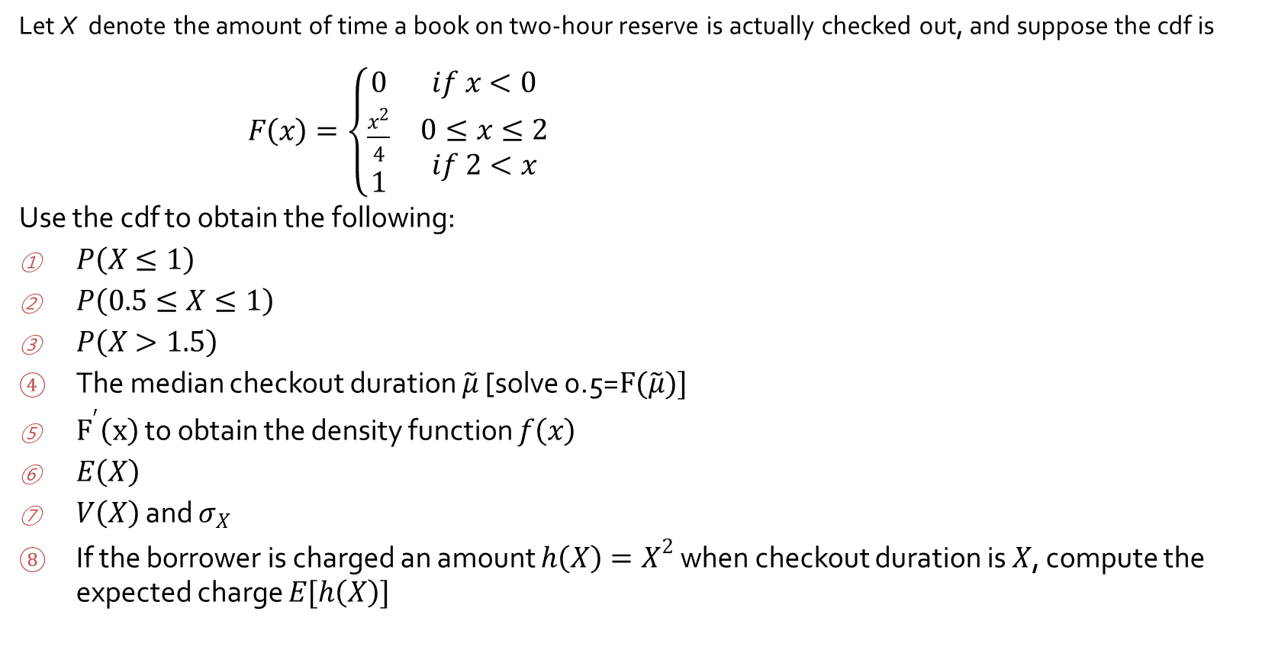
Exercise (4.2) 11
Let X denote the amount of time a book on two-hour reserve is actually checked out, and suppose the cdf is
$F\left(x\right)=\left\{\begin{matrix}0 & if x<0 \\ \begin{matrix}\frac{x^{2}}{4} \\ 1\end{matrix} & \begin{matrix}0≤x≤2 \\ if 2<x\end{matrix}\end{matrix}\right.$
Use the cdf to obtain the following:
$P\left(X≤1\right)$
$P\left(0.5≤X≤1\right)$
$P\left(X>1.5\right)$
The median checkout duration $\tilde{μ}$ [solve 0.5=$F(\tilde{μ})]$
$F^{′}\left(x\right)$ to obtain the density function $f\left(x\right)$
$E\left(X\right)$
$V\left(X\right)$ and $σ_{X}$
If the borrower is charged an amount $h\left(X\right)=X^{2}$ when checkout duration is $X$, compute the expected charge $E[h\left(X\right)]$

Slide 10
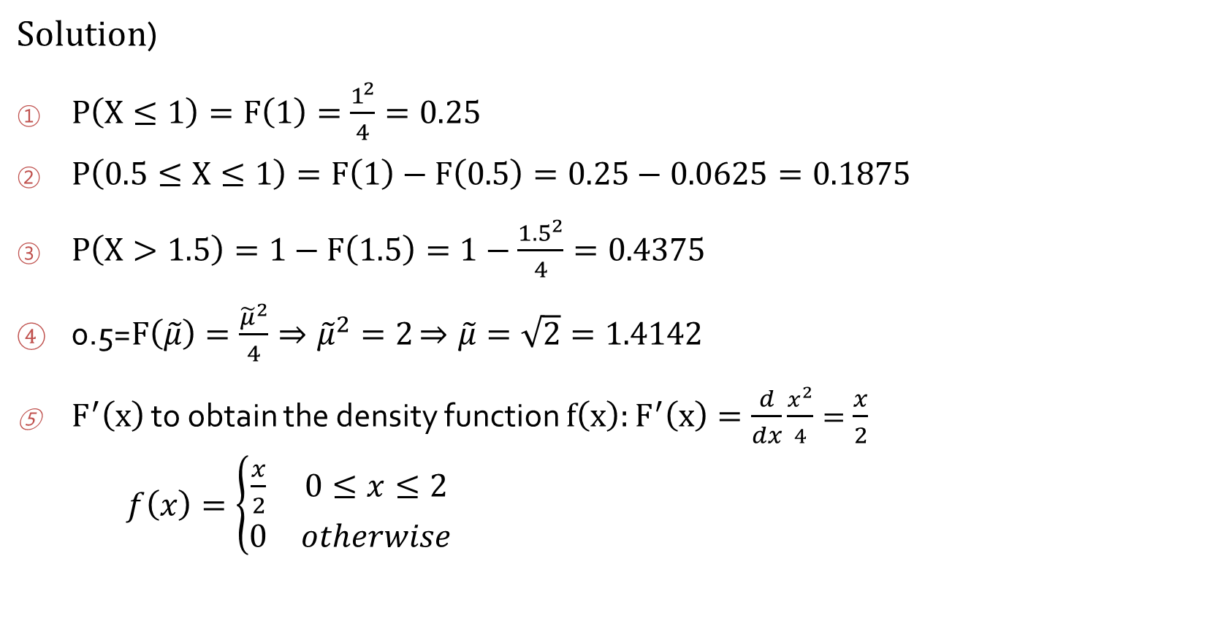
Exercise (4.2) 11
$Solution$)
$P\left(X≤1\right)=F\left(1\right)=\frac{1^{2}}{4}=0.25$
$P\left(0.5≤X≤1\right)=F\left(1\right)−F\left(0.5\right)=0.25−0.0625=0.1875$
$P\left(X>1.5\right)=1−F\left(1.5\right)=1−\frac{{1.5}^{2}}{4}=0.4375$
0.5=$F\left(\tilde{μ}\right)=\frac{{\tilde{μ}}^{2}}{4}⇒{\tilde{μ}}^{2}=2$ $⇒\tilde{μ}=\sqrt{2}=1.4142$
$F^{′}\left(x\right)$ to obtain the density function $f\left(x\right):F^{′}\left(x\right)=\frac{d}{dx}\frac{x^{2}}{4}=\frac{x}{2}$
$f\left(x\right)=\left\{\begin{matrix}\frac{x}{2} & 0≤x≤2 \\ 0 & otherwise\end{matrix}\right.$

Slide 11
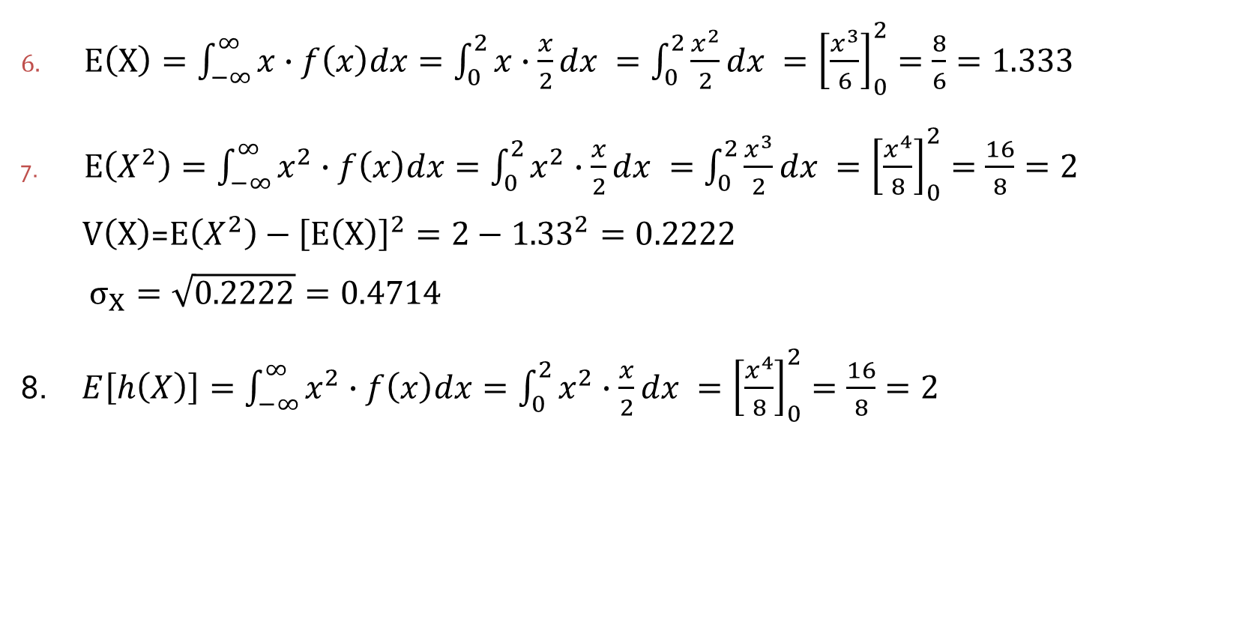
Exercise (4.2) 11
$E\left(X\right)=\int_{−∞}^{∞}{x∙f\left(x\right)dx}={\int_{0}^{2}{x∙\frac{x}{2}dx }=\int_{0}^{2}{\frac{x^{2}}{2}dx }=\left[\frac{x^{3}}{6}\right]}_{0}^{2}=\frac{8}{6}=1.333$
$E\left(X^{2}\right)=\int_{−∞}^{∞}{x^{2}∙f\left(x\right)dx}=\int_{0}^{2}{x^{2}∙\frac{x}{2}dx }=\int_{0}^{2}{\frac{x^{3}}{2}dx }={\left[\frac{x^{4}}{8}\right]}_{0}^{2}=\frac{16}{8}=2$
$V\left(X\right)$=$E\left(X^{2}\right)−{\left[E\left(X\right)\right]}^{2}=2−{1.33}^{2}=0.2222$
$σ_{X}=\sqrt{0.2222}=0.4714$
8. $E\left[h\left(X\right)\right]=\int_{−∞}^{∞}{x^{2}∙f\left(x\right)dx}=\int_{0}^{2}{x^{2}∙\frac{x}{2}dx }={\left[\frac{x^{4}}{8}\right]}_{0}^{2}=\frac{16}{8}=2$

